Slide 1
“GIVEN THE INCREDIBLE POWER OF NEW TECHNOLOGIES WE SHOULD PROCEED WITH GREAT CAUTION ”
- BILL JOY, “ WHY THE FUTURE DOESN’T NEED US ”
TECHBYTES

Slide 2
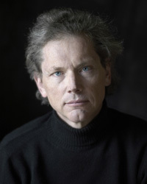

WILLIAM NELSON “BILL” JOY
An American computer scientist
Co-founder of Sun Microsystems
Original author of the vi text editor
Dystopian views of future

Slide 3
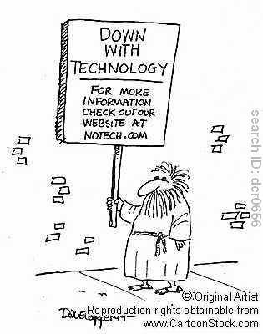
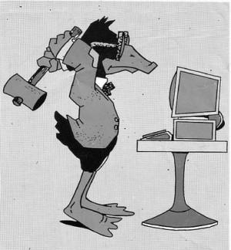
JOY HAS BEEN COMMONLY REFERRED TO AS “NEO-LUDDITE”
A Luddite being someone in opposition to new technology

Slide 4
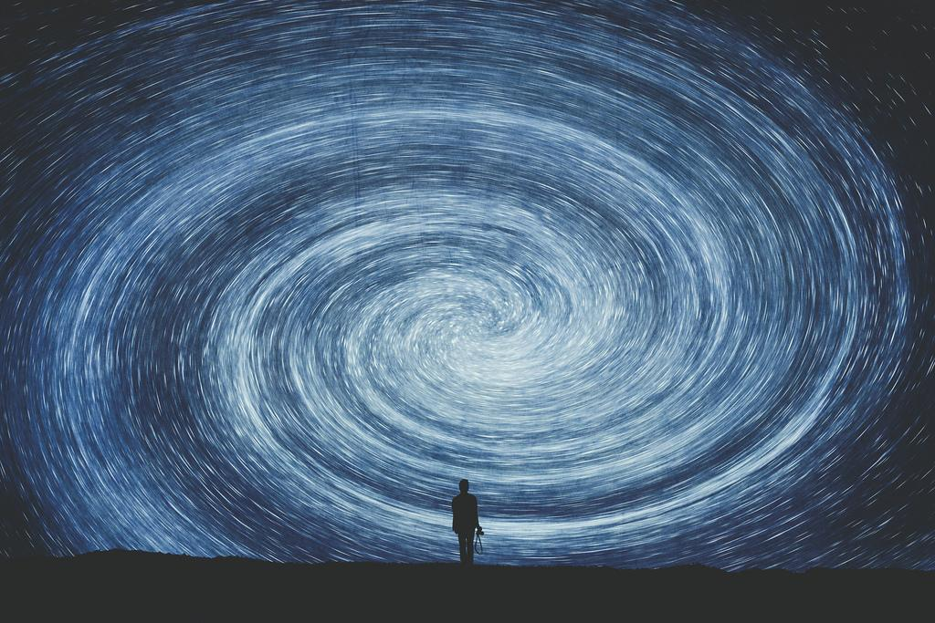
“PERHAPS IT IS ALWAYS HARD TO SEE THE BIGGER IMPACT WHEN YOU ARE IN A VORTEX OF CHANGE” - JOY
Joy also discusses the views of specialists in other scientific areas.

Slide 5
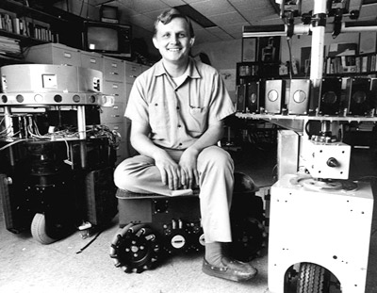
HANS MORAVEC
A leader in robotics research
Founder of the world’s largest robotics research program at Carnegie Mellon University.

Slide 6

“Government coerces non-market behavior, especially by collecting taxes. Judiciously applied, governmental coercion could support human populations in high style on the fruits of robot labor, perhaps for a long while.” - Moravec

Slide 7
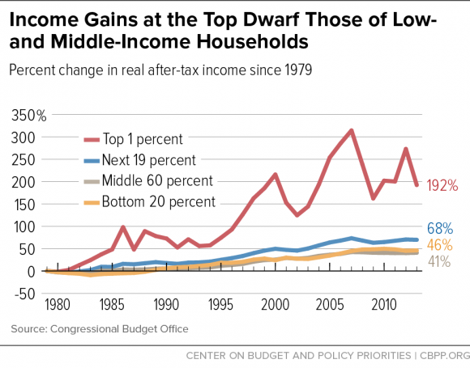

Slide 8
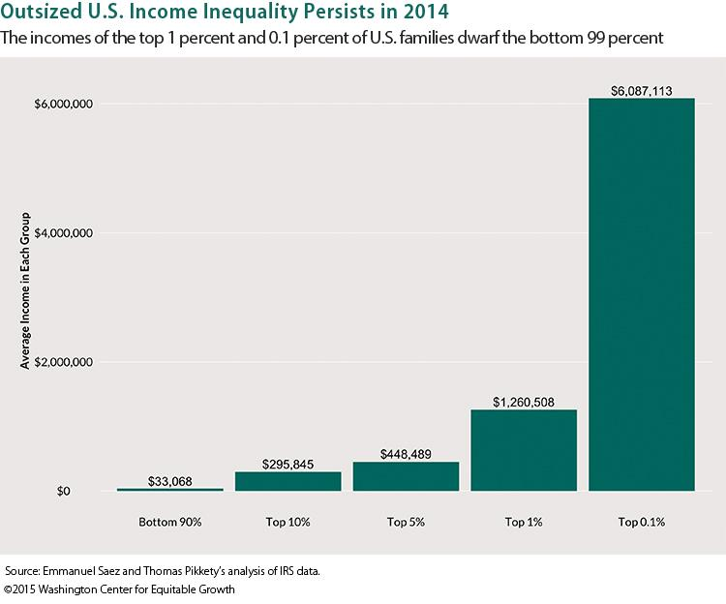

Slide 9
The reality is that these rapid technological advancements aren’t as easily controllable or re-distributable as Moravec suggested.
The development of revolutionary technology has always been succeeded by a perceptible change in the status quo.

Slide 10
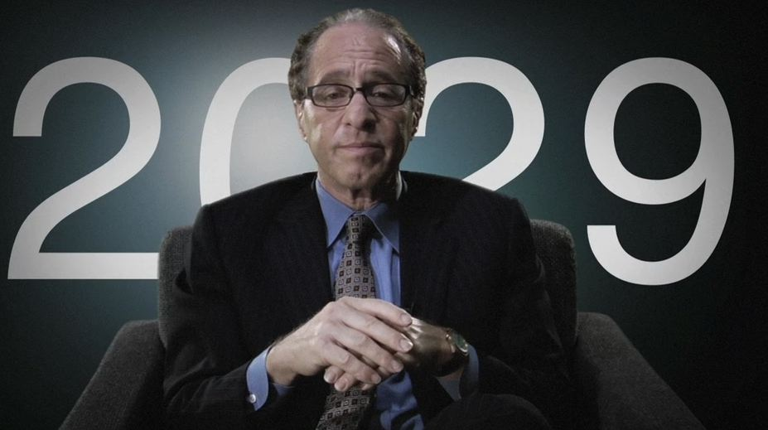
RAY KURZWEIL
Pro-cybernetics
Utopian views
Joy didn’t agree with him, thought his views ignored possible dangers

Slide 11
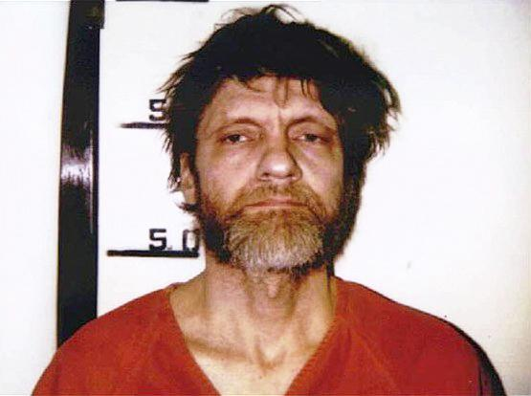
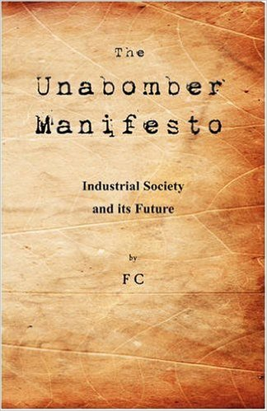
THEODORE KACZYNSKI AKA THE UNABOMBER
Terrorist
Highly dystopian
Posed two possible scenarios
One – Robots do all work instead of humans
Two – ‘Tiny elite’ controls all robots and technology

Slide 12
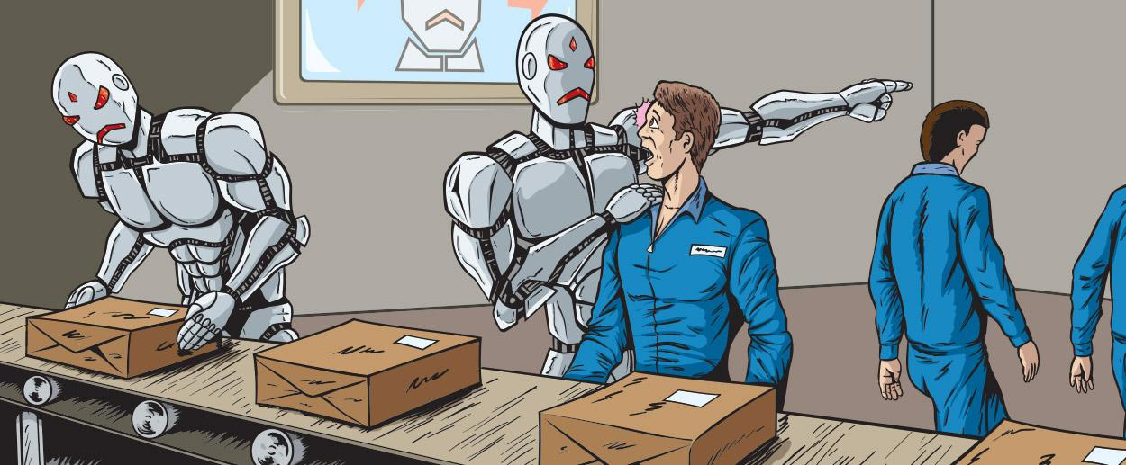
Is this just an alarmist dystopian view?
Our society is undeniably becoming more reliant on machines.
For example, driverless cars and Artificial Intelligence
We may be far closer to the finish line than we once thought.

Slide 13
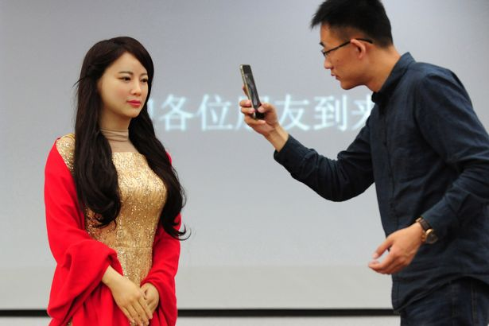
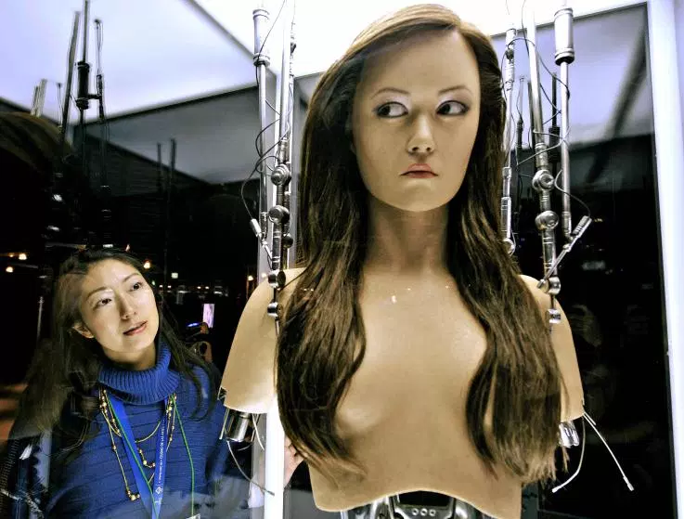
Will the meaning of being human be redefined?

Slide 14
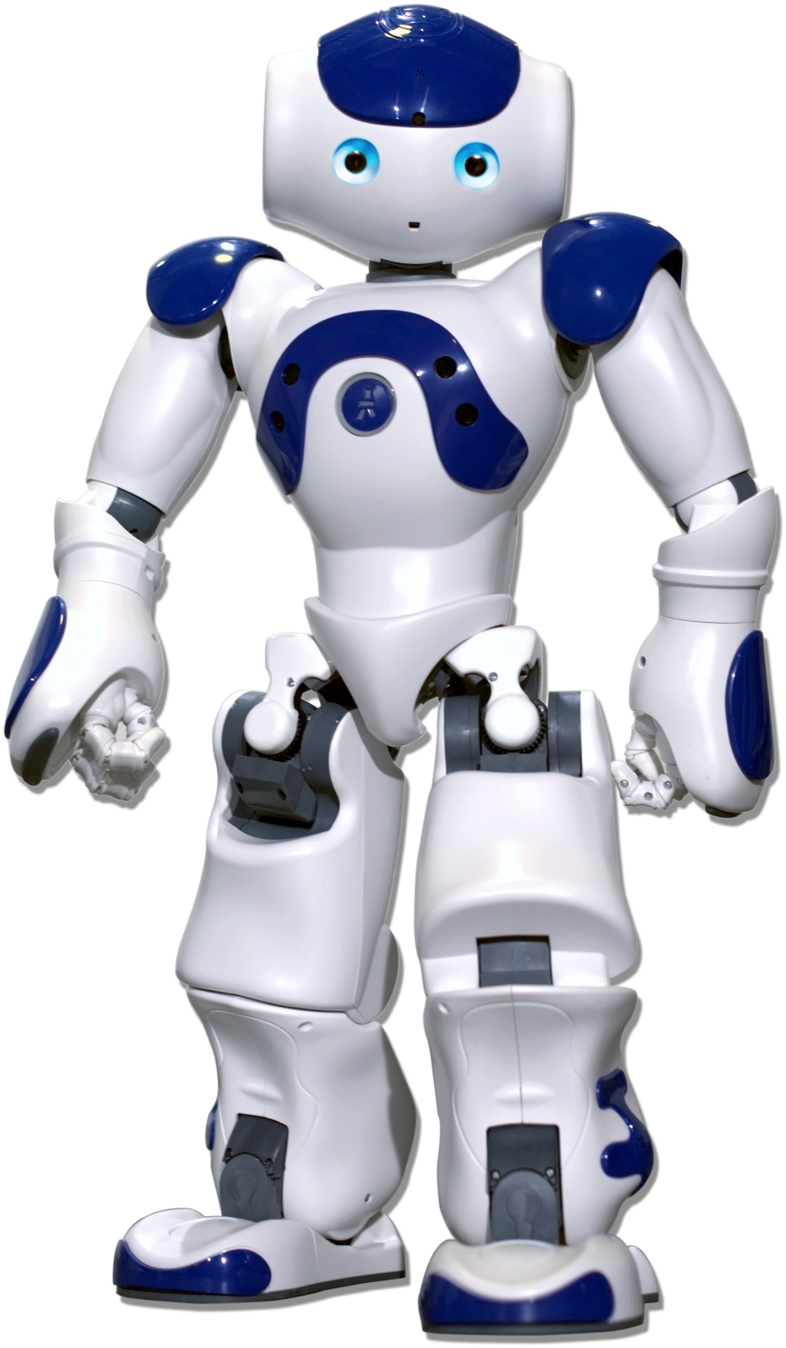
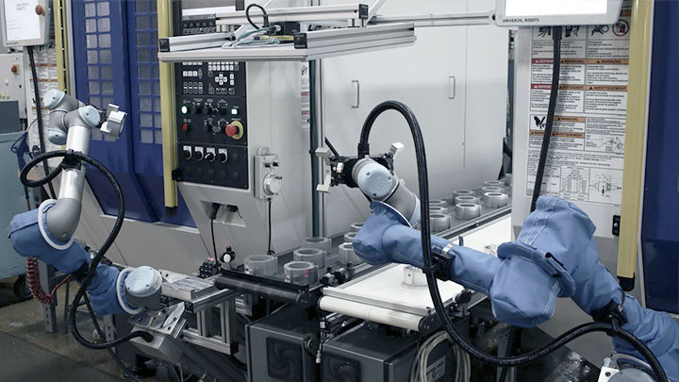
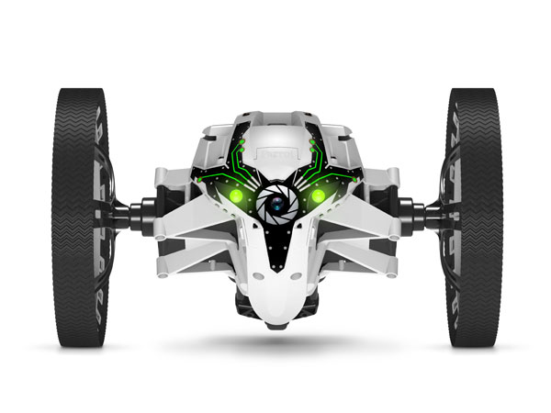

Slide 15

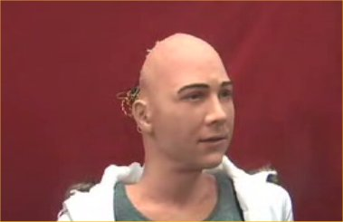
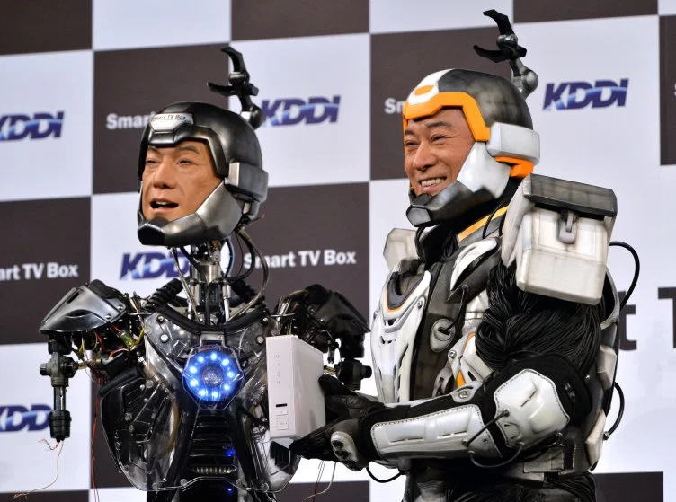
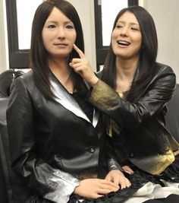
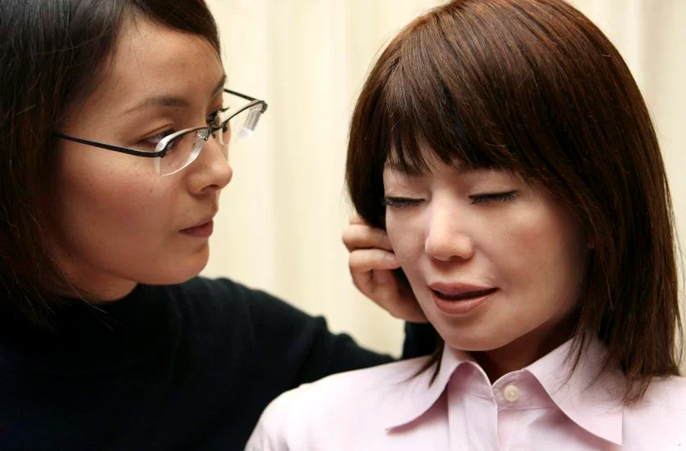

Slide 16
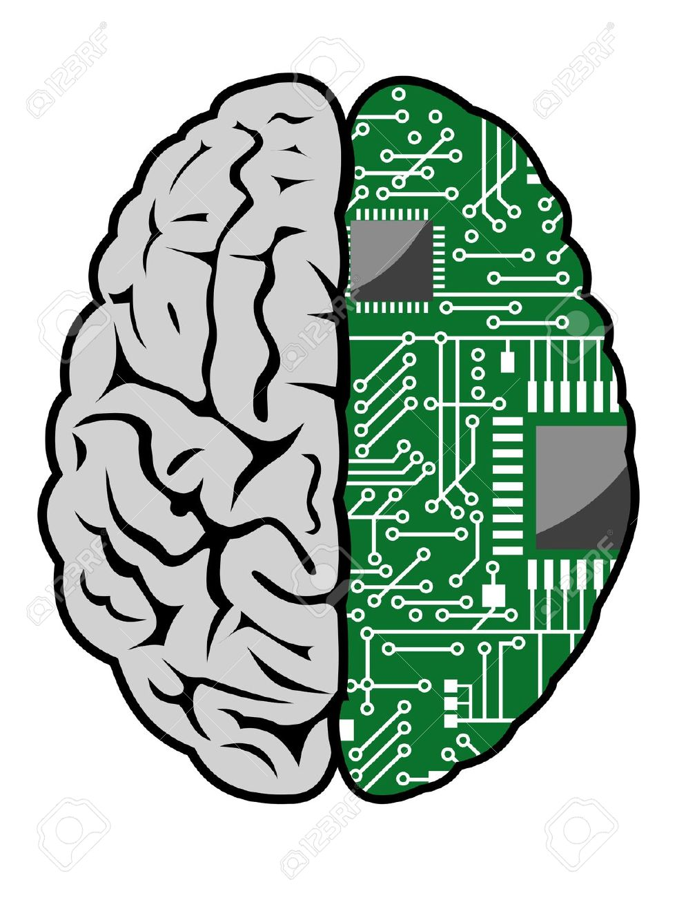
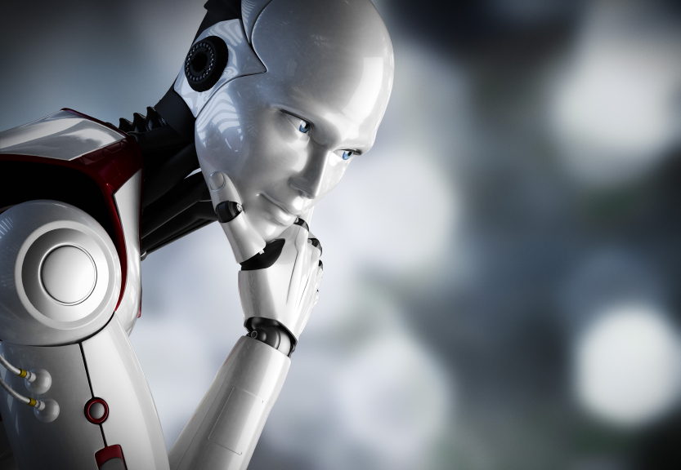
What if these robot brains have far more human neurons than a typical human brain?
Would they, rather than humans, make all future decisions?

Slide 17

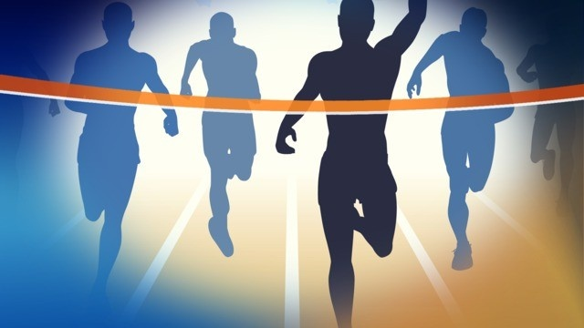




The development of AI has become a race between some of the greatest governments and companies in the world.

Slide 18
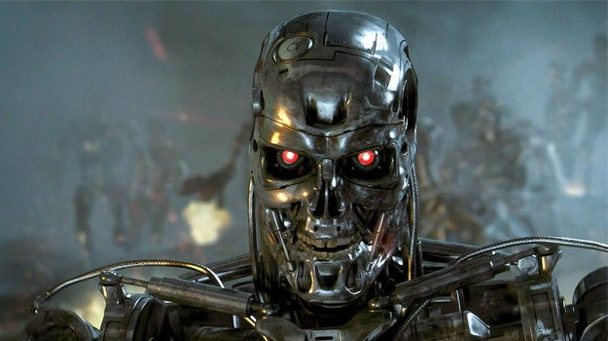
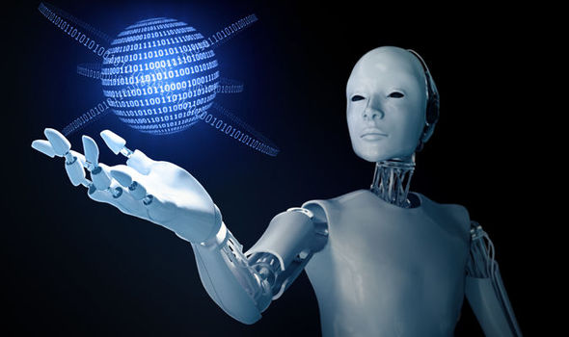
AI is one of the only things that man has created that functions in a way we can't predict.

Slide 19
JUST BECAUSE WE CAN DO SOMETHING, SHOULD WE DO IT?

Slide 20
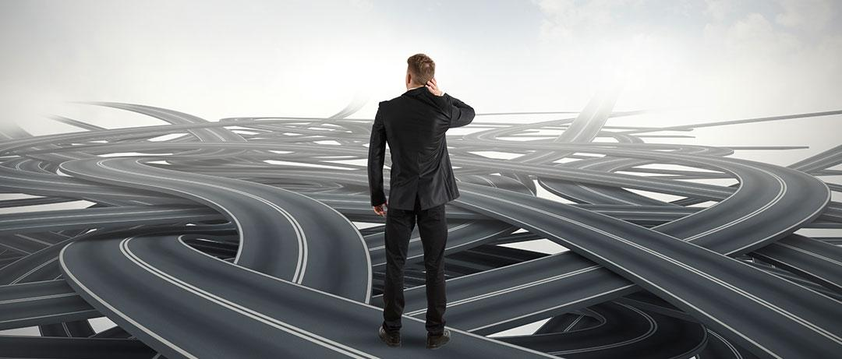
We should be cautious because humans are developing technology that will eventually have super human intelligence and capabilities.
It would be foolish to simply assume a techno-utopian view and hope things will work out fine.

Slide 21
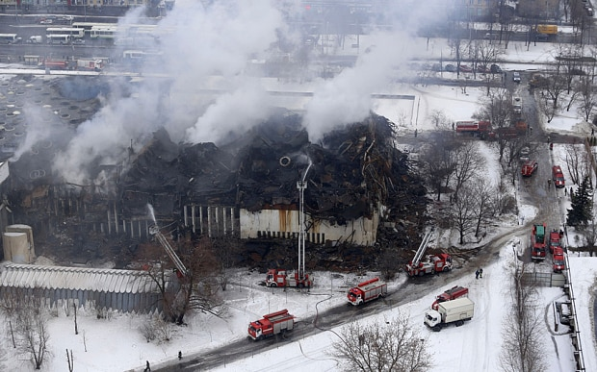
Murphy’s law
“Anything that can go wrong, will.”
(Chernobyl)

